Slide 1
COURSE CODE:
INFT 352
TITLE:
Advanced Web Engineering and Application With PHP
LECTURER/ INSTRUCTOR: P.M SARFO

Slide 2
PHP Basics: Output, Variables, Control Structures
PHP Basics: Output, Variables, Control Structures

Slide 3
Variables and Data Types
A variable is a named memory location that contains data and may be manipulated throughout the execution of the program.
A variable is a symbol that can store different values at different times.
Variable Declaration A variable always begins with a dollar sign, $, which is then followed by the variable name
Variable name can begin with either a letter or an underscore and can consist of letters, underscores, numbers.

Slide 4
Variables and Data Types
Variables start with $, e.g.,
$name = "Alice";
PHP is loosely typed: it figures out the type based on the value.
It is case sensitive.
• $color
• $Color
• $COLOR

Slide 5
Common types:
String: "hello“
Integer: 123
Float: 3.14
Boolean: true / false
Array: ["apple", "banana"]

Slide 6
Value Assignment
Assignment by value simply involves copying the value of the assigned expression to the variable assignee. This is the most common type of assignment. A few examples follow:
$color = "red";
$number = 12;
$age = 12;
$sum = 12 + "15"; // $sum = 27

Slide 7
Output in PHP
Used to display content in the browser.
echo and print:
echo "This is output using echo.<br>";
print "This is output using print.";

Slide 8
Arrays in PHP
An array in PHP is actually an ordered map. A map is a type that associates values to keys. This type is optimized for several different uses; it can be treated as an array, list (vector), hash table (an implementation of a map), dictionary, collection, stack, queue, and probably more. As array values can be other arrays, trees and multidimensional arrays are also possible.

Slide 9
An array can be created using the array() language construct. It takes any number of comma-separated key => value pairs as arguments.
array(
key1 => value,
key2 => value2,
key3 => value3,
...
)

Slide 10
An array is a special variable that can hold many values under a single name, and you can access the values by referring to an index number or name.
$fruits = ["Apple", "Banana", "Cherry"];
echo $fruits[1]; // Output: Banana

Slide 11
Control Structures
Control structures determine the flow of code within an application, defining execution characteristics such as whether and how many times a particular code statement will execute, as well as when a code block will relinquish execution control.

Slide 12
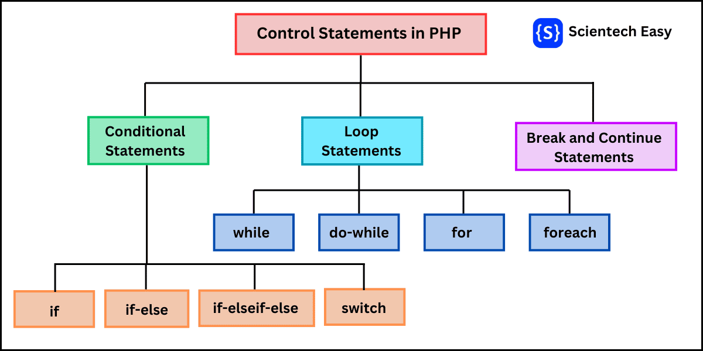

Slide 13
Introduction to HTML/PHP integration.
<!DOCTYPE html>
<html>
<head><title>PHP Example</title></head>
<body>
<h1>Welcome!</h1>
<p>
<?php
$username = "Alice";
echo "Hello, $username!";
?>
</p>
</body>
</html>

